Slide 1
Naïve Bayes
By: Dylan Williams, Burke Landon, and Kristof Bothazi

Slide 2
What is it and what is it used for?
It is a simple technique for constructing classifiers: models that assign class labels to problem instances, represented as vectors of feature values, where the class labels are drawn from some finite set.
It performs well in cases of categorical input variables compared to numerical variables
It is useful for making predictions and forecasting data based on historical results.

Slide 3
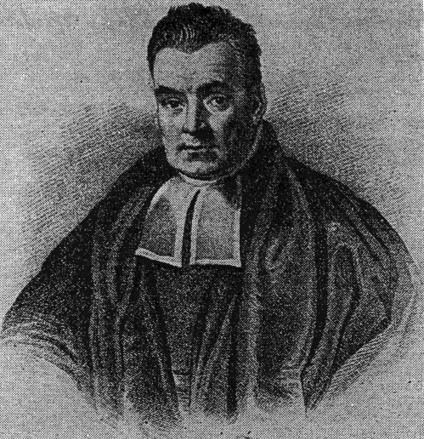
Thomas bayes
The man who founded “Bayes Theorem” (which is what Naïve Bayes is based on)
Born in Hertfordshire, England 1701 – 1761
Studied logic and Theology at the University of Edinburgh
He didn’t become famous until after his death because it was his friend Richard Price who published his work on Probability

Slide 4

Bayes’ theorem formula
P(A|B) is read as “The probability that A will happen given that B has happened”
One of the many uses of Bayes’ Theorem is called Bayesian Inference
This is used in medicine, science, philosophy, engineering, sports, law, etc.
Bayes’ theorem relies on consolidating prior probability distributions to generate posterior probabilities
The time complexity is O(nM), where n is the number of classes and M is the number of types of information it is checking

Slide 5
Real world applications
Naive Bayes classifiers work by correlating the use of tokens (typically words, or
sometimes other things) and then use Bayes' theorem to calculate the probability of its
likelihood
Naive Bayes is mostly used in real-world applications like
Sentiment Analysis
Spam Filtering
Recommendation Systems
Note: These are some examples we chose to list and briefly talk about, but there certainly are more than just these 3.

Slide 6
Sentiment Analysis
Sentiment analysis is an approach to natural language processing (NLP) that identifies the emotional tone behind a body of text.
Examples of where it’s used:
Brand Monitoring
Market Research and Analysis
Social Media Monitoring

Slide 7
Spam Filtering
A spam filter is a program used to detect unsolicited, unwanted and virus-infected emails and prevent those messages from getting to a user's inbox.
With spam and non-spam e-mails, Bayes' theorem is used to calculate a probability that an email is or is not spam.
(Of course, this can work in instances besides e-mails. It’s just the most common example)

Slide 8
Recommendation Systems
A Recommendation System is a subclass of information filtering system that provide suggestions for things that are most pertinent to a particular user or users
Types:
Generalized – Information is taken from multiples sources, and a recommendation is made based off of the majority’s opinion/decision
Examples:
Movies
Products
Personalized – Information is taken based on an individual’s personal preferences, and a recommendation is made for their specific wants and needs
Examples:
Social Media
Ads

Slide 9
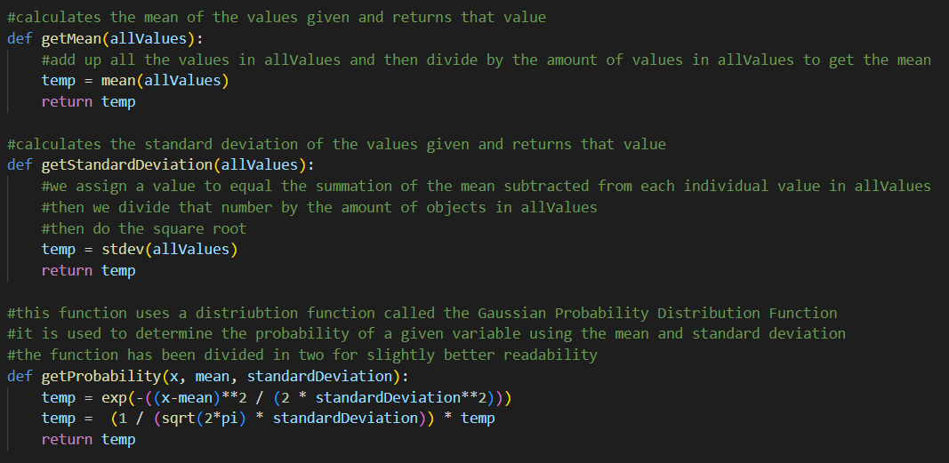
Calculating probability

Slide 10
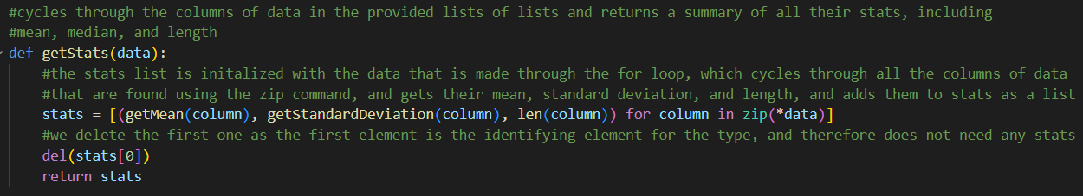
Calculate statistics

Slide 11
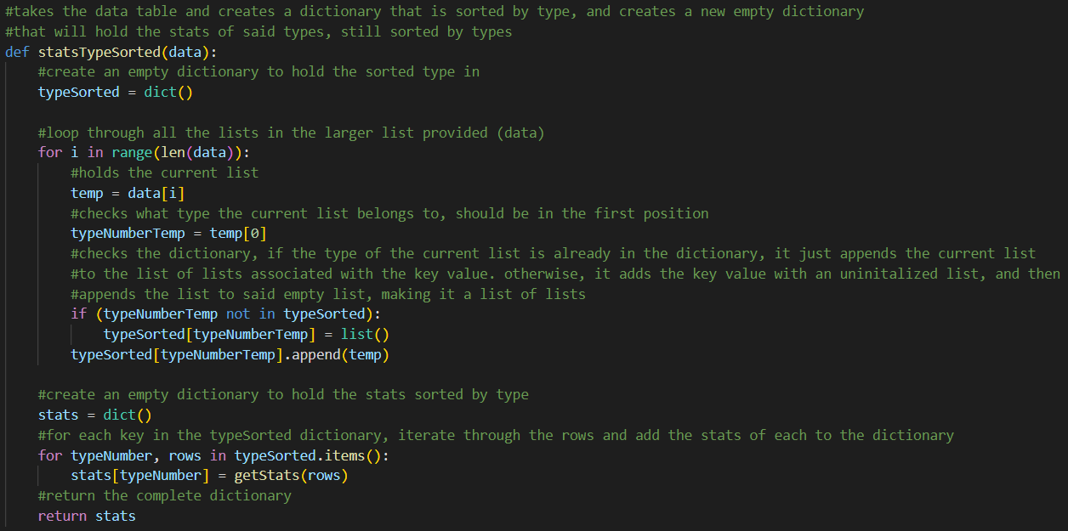
Compile Statistics

Slide 12
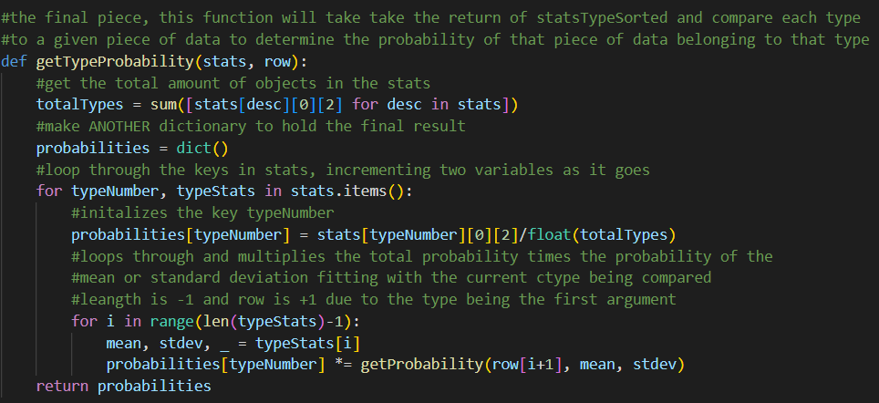
Compile probabilities

Slide 13
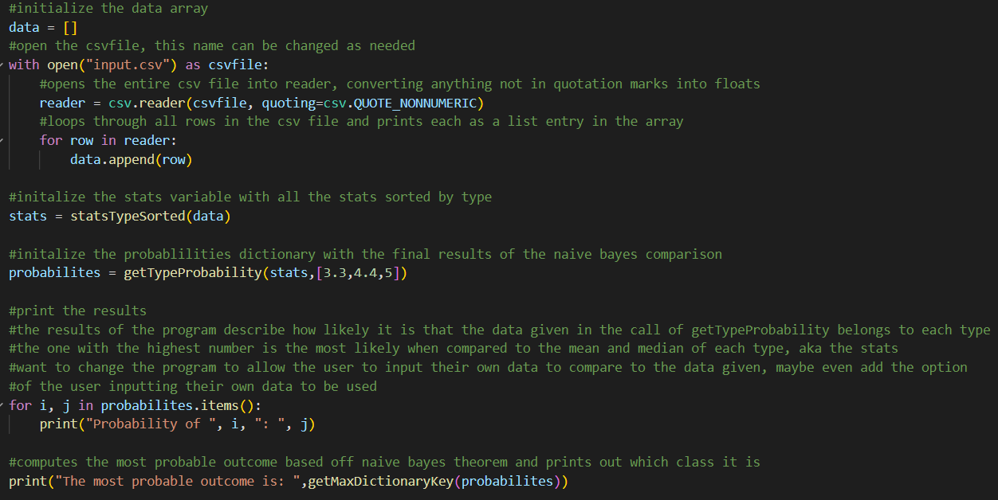
main

Slide 14
Time to demo the code!
You will notice that each outcome’s likelihood is separate from the others

Slide 15

Any questions?

